Slide 1
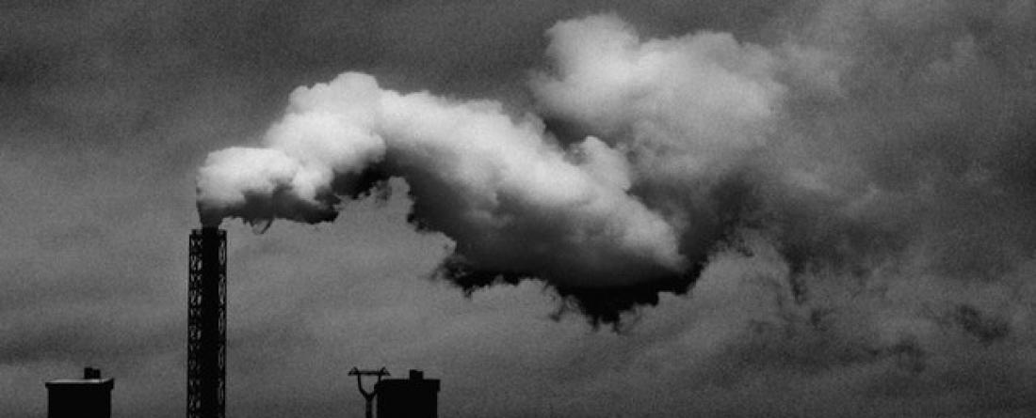
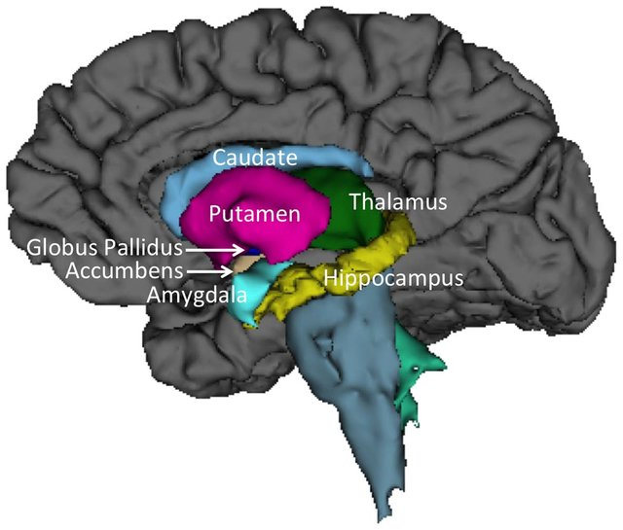
Prenatal PM_{2.5} and subcortical volumes in children with neurodevelopmental disorders
Elza Rechtman¹, Lindsay M. Alexander², Esmeralda Navarro¹, Demetrios M. Papazaharias¹, Allan Just¹, Robert Wright¹, Michael P. Milham², Chris Gennings¹, Megan K. Horton¹
Author Affiliations: 1 - Department of Environmental Medicine and Public Health, Icahn School of Medicine at Mount Sinai, New York, NY, USA, 2 - Healthy Brain Network, Child Mind Institute, New York, NY, USA
Key findings: Prenatal exposure to PM_{2.5} may be associated with increased subcortical volumes in children later diagnosed with neurodevelopmental disorders (5-15 years)
Background
With the growing climate crisis, particulate matter (PM) air pollution is expected to increasingly impact human health with effects magnified in vulnerable populations including pregnant women and young children.
Air pollution (particulate matter < 2.5 um; PM2.5) exposure increases risk for autism spectrum disorder (ASD) and attention deficit hyperactivity disorder (ADHD), yet the neural mechanisms underlying these associations are largely unknown.
To understand links between prenatal PM2.5 exposure and structural brain changes, we take a transdiagnostic approach in a cohort enriched with ASD and ADHD subjects.
Materials and Methods
Participants: 238 children enrolled in the Healthy Brain Network (HBN); behavioral and magnetic resonance imaging (MRI) phenotyping biobank.
Exposure: We estimated average prenatal PM2.5 levels using a satellite-based gradient boosting hybrid model at a 1x1 km spatial resolution.
Outcome: Subcortical volumes (14) from high-resolution structural T1-weighted images
Statistical analysis: Weighted quantile sum (WQS) regression to generate a subcortical volume index (representing 14 subcortical brain regions volumes) and investigated associations between the subcortical index and PM2.5.
WQS-SCV Index
Gestational average PM_{2.5}
Results
Figure 1. PM_{2.5} Distribution of prenatal average PM2.5 among 557 participants enrolled in HBN, stratified by Dx.
Figure 2. PM_{2.5} exposure profile from 37 weeks (~259 days) before birth to birth (time 0) in 3 HBN subjects. Individual PM2.5 ranges 2 to 37 µg/m3.
PM_{2.5} was positively associated with the subcortical index (β = 0.19 [95% CI 0.18, 0.20), indicating higher prenatal exposure to PM_{2.5} is associated with increased subcortical volumes. This association is driven mainly by volumetric changes in the thalamus and pallidum.
Figure 3. Associations between prenatal PM_{2.5} and the WQS subcortical volumes index from weighted quantile sum (WQS) regression among 238 HBN participants. (A) Regression lines and standard errors between PM_{2.5} and the WQS index. (B) Estimated weights contributing to overall effect.
Conclusions
Prenatal exposure to PM_{2.5} is associated with changes in subcortical volumes in a pediatric population enriched with ASD and/or ADHD
This association is driven mainly by volumetric changes in the thalamus and pallidum, regions that play key roles in ASD and ADHD.
These preliminary results should be replicated in a larger cohort and expand to associations with cognition and behavior

